Slide 1

.NET Core in 2017
Łukasz Pyrzyk
@lukaszpyrzyk

Slide 2
About me
Senior Software Developer at Ryanair
Fan of performance, threading, bits and bytes
Experience in .NET Core since beta6
.NET Core Tour coorganizer
@lukaszpyrzyk

Slide 3







pyrzyk.net/tour

Slide 4
Agenda
How .NET looks today
.NET of tomorrow
.NET Standard
Upcoming features to .NET Core
@lukaszpyrzyk

Slide 5
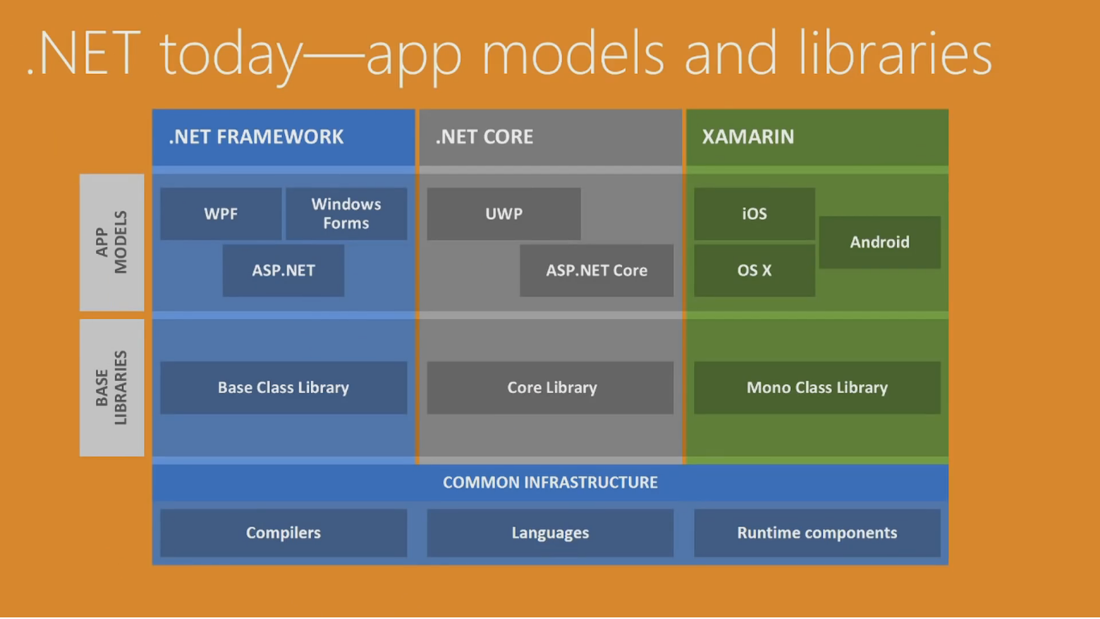
Notes:
It does not mean if you are web dev or mobile dev
.NET across all operating system
Three ways
BCL created by different people, in different time

Slide 6

Notes:
Zajebiście, siadam i koduje

Slide 7

Missing API and Types
@lukaszpyrzyk
Notes:
1. Newbe and .NET Serialization
2. Mono and unity (TPL)
3. How to compile for the platform

Slide 8
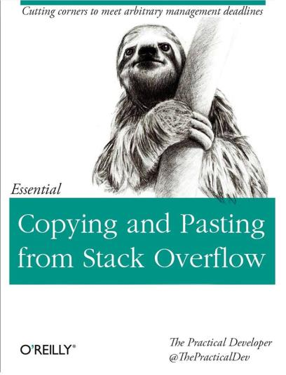
Missing API and Types
@lukaszpyrzyk
Notes:
1. Newbe and .NET Serialization
2. Mono and unity (TPL)
3. How to compile for the platform

Slide 9
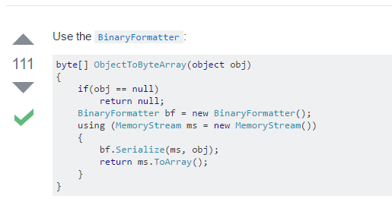
Missing API and Types
@lukaszpyrzyk
Notes:
1. Newbe and .NET Serialization
2. Mono and unity (TPL)
3. How to compile for the platform

Slide 10
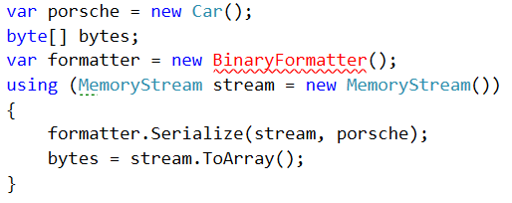
Missing API and Types
@lukaszpyrzyk
Notes:
1. Newbe and .NET Serialization
2. Mono and unity (TPL)
3. How to compile for the platform

Slide 11
Problems
Missing API and Types
Differences between BCLs
Difficult to reuse the code and create library
@lukaszpyrzyk
Notes:
2. Mono and unity (TPL)
3. How to compile for the platform. JSON w Unity

Slide 12
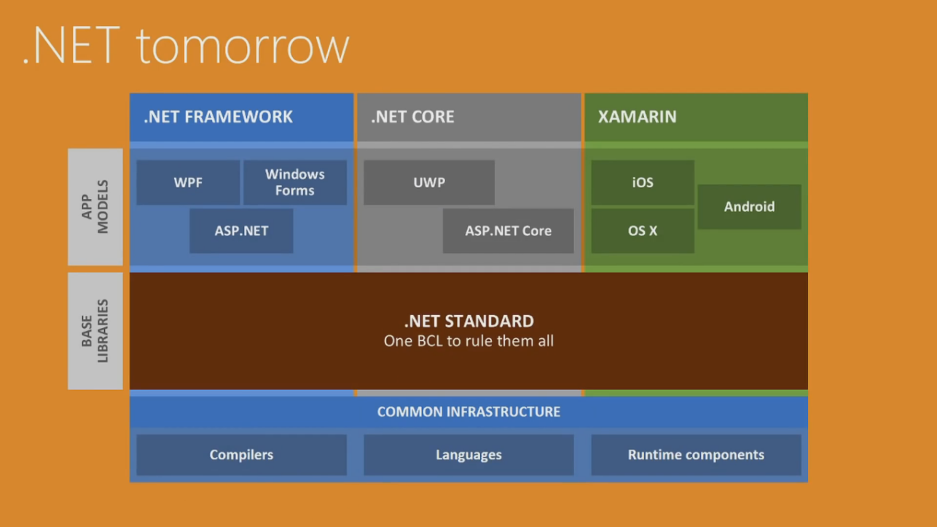
Notes:
Interface or group of interfaces around BCL

Slide 13
Choosing a .NET Standard version
.
NET Standard 1.0, 1.1, 1.2, 1.3, 1.4, 1.5, 1.6
The higher the version, the more APIs are available to you.
The lower the version, the more platforms you can run on.
@lukaszpyrzyk

Slide 14
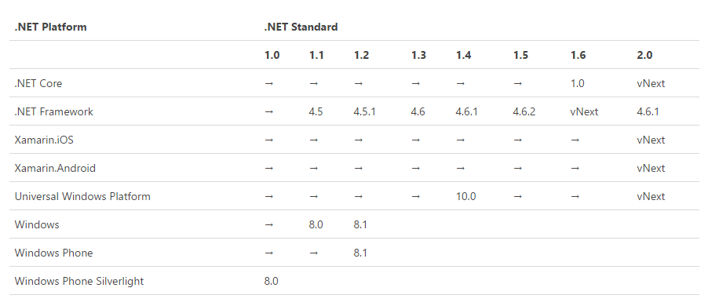
@lukaszpyrzyk
Notes:
Subset of interfaces over the APIs

Slide 15
What is not implemented?
Runtime specific APIs like System.Reflection.Emit
Operating system APIs like Windows registry
@lukaszpyrzyk
Notes:
UWP runs on .NET Core

Slide 16
Options
Delete problematic API from the Standard
Throw PlatformNotSupportedException when it is needed
Emulate
@lukaszpyrzyk
Notes:
Mutex throws exception
Mono emulates Registry with .ini files

Slide 17
Decisions
Windows Registry
nuget package (Microsoft.Win32.Registry), available only on Windows
AppDomain
exceptions on platforms that don’t support that, such as .NET Core
Emit
interpreting expression trees instead of compiling them
Exception when compiling regex
@lukaszpyrzyk

Slide 18
Analysis tool
.NET API Portability tool
cmd >> apiport analyze -f C:\src\mylibs\ -t ".NET Standard,Version=1.6"^
VS addin - .NET Portability Analyzer
@lukaszpyrzyk

Slide 19
.NET Standard 2.0
No breaking change ☺
Strict superset of .NET Standard 1.6
Allows referencing existing binaries, even if they weren't built for .NET Standard or PCL
More APIs…
@lukaszpyrzyk

Slide 20

.NET Standard 2.0
@lukaszpyrzyk

Slide 21
.NET Standard 2.0
Version | APIs | Growth %
1.0 | 7,949
1.1 | 10,239 | +29%
1.2 | 10,285 | +0%
1.3 | 13,122 | +28%
1.4 | 13,140 | +0%
1.5 | 13,355 | +2%
1.6 | 13,501 | +1%
2.0 | 32,638 | +142%
@lukaszpyrzyk

Slide 22
When?
@lukaszpyrzyk

Slide 23
Dates
Milestone | Release Date
.NET Core 2.0 Preview | Q2 2017
.NET Standard 2.0 Preview | Q2 2017
.NET Core 2.0 | Q3 2017
.NET Standard 2.0 | Q3 2017
@lukaszpyrzyk
Notes:
Informacja o twitterze

Slide 24
.NET Core upcoming features
Slice<T> in System.Slices
@lukaszpyrzyk

Slide 25
Span<T>
It is a simple and small struct which gives easy access to memory. Span exposes API for working with any kind of buffers, arrays and strings.
Type-safe
Memory-safe
Very fast
@lukaszpyrzyk

Slide 26
Span<T>
Pointer
Offset
Length
0xFFFFFFFF
3
4
0
1
2
3
4
5
6
7
@lukaszpyrzyk

Slide 27
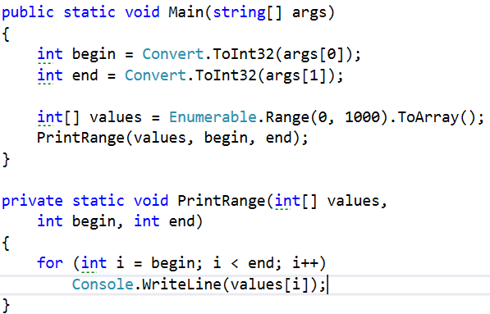
1. Pass begin and end
@lukaszpyrzyk

Slide 28
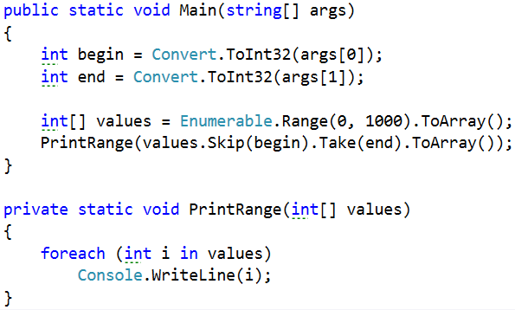
2. Copy array to smaller
@lukaszpyrzyk

Slide 29
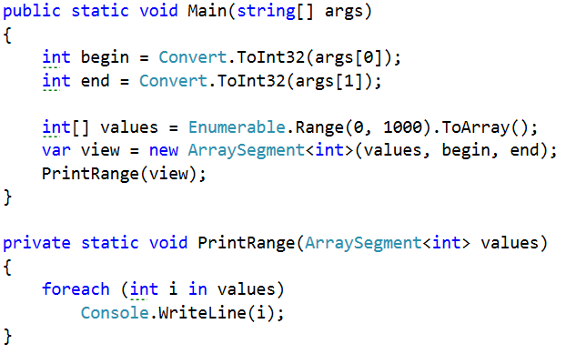
3. Use ArraySegment
@lukaszpyrzyk

Slide 30
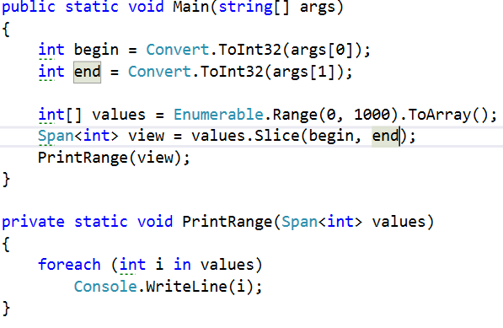
3. Use Span<T>
@lukaszpyrzyk

Slide 31
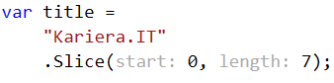
Span<T>
@lukaszpyrzyk

Slide 32
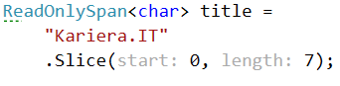
Span<T>
@lukaszpyrzyk

Slide 33
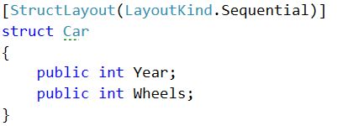
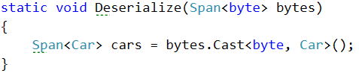
Span<T>
@lukaszpyrzyk

Slide 34
Another upcoming features
Slice<T> in System.Slices
ArrayPool in System.Buffers
@lukaszpyrzyk

Slide 35
ArrayPool<T>
Provides a resource pool for buffering and reusing T[]
Available in System.Buffer package
@lukaszpyrzyk
Notes:
Robienie gier - pooling

Slide 36
ArrayPool<T> - steps to use
Define a pool
ArrayPool<T>.Shared
ArrayPool<T>.Create()
NativeBufferPool<T>.SharedByteBufferPool
Custom
Rent array
Use it
Return array
Do not rely on the Length property
@lukaszpyrzyk
Notes:
Robienie gier - pooling

Slide 37
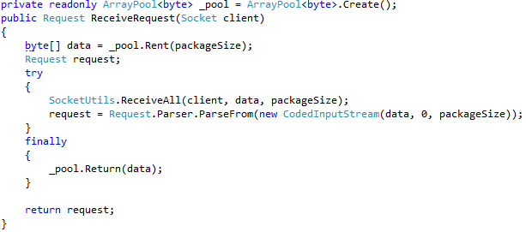
ArrayPool<T>
@lukaszpyrzyk

Slide 38
Another upcoming features
Slice<T> in System.Slices
ArrayPool in System.Buffers
ValueTask in System.Threading.Tasks.Extensions
Native zlib in System.IO.Compression
Pipelines in System.IO.Pipelines
@lukaszpyrzyk

Slide 39
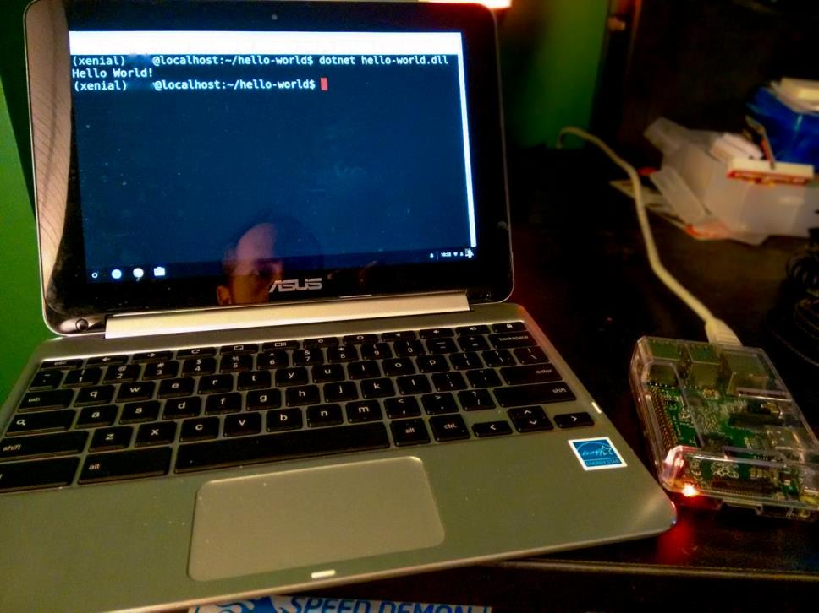

Slide 40
ARM
Desktops, laptops and servers run on platform called x86-64 (or "x64" for short): the 64-bit version of x86
ARM has been created for mobile and embedded systems, physical footprint and power efficiency is over performance. Currently there is a 20 billion active ARM devices worldwide
@lukaszpyrzyk

Slide 41
7 things to know
Release Date – Q4 2017
Ability to reference full framework libraries
APIs are back
csproj is back
Msbuild is back
Visual Studio 2017 tooling is finaly RTM
ARM is coming ☺
@lukaszpyrzyk

Slide 42
Questions? @lukaszpyrzyk https://pyrzyk.net

